Slide 1
LINUX PROGRAMMES
By,
ALEENA JOSEPH

Slide 2
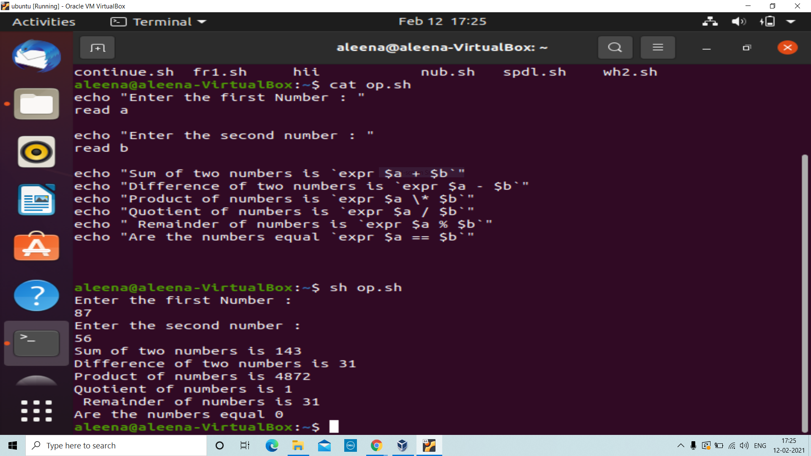
Boolean operators
Shown is a program created in Ubuntu for displaying the various Boolean operations between two numbers. The editor used is vi editor.
cat op.sh: Shows the full shell script
sh op.sh: Displays the output.

Slide 3
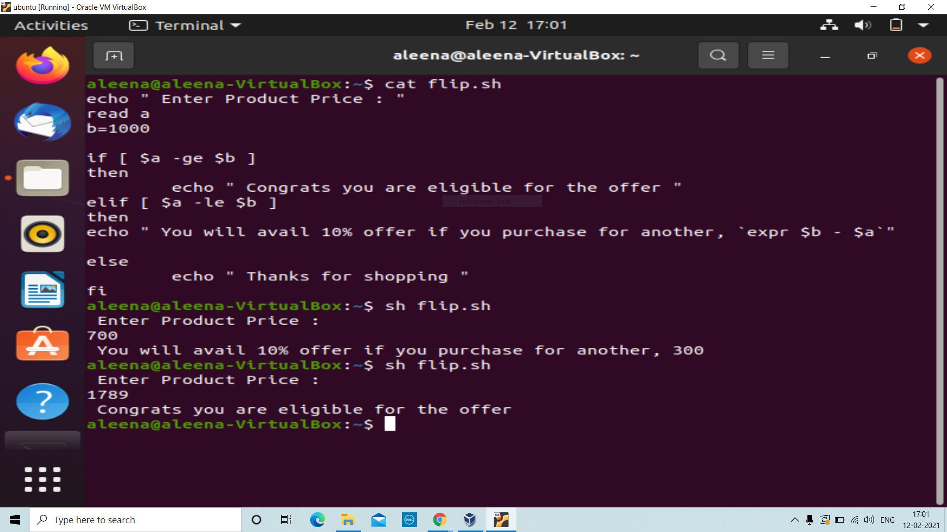
Code to check whether a product is availing any discounts:
cat flip.sh: Shows the shell script
sh flip.sh: Displays the output

Slide 4
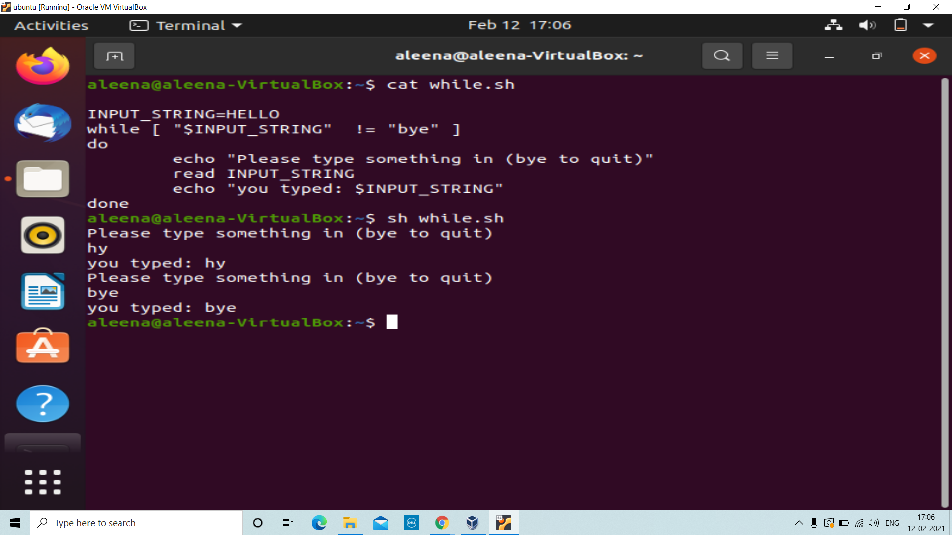
Shell script displaying the use of while loop.
Displayed here is a program which only quits when “bye” is given as an input.
Syntax: while [ expression]
do
statements
done

Slide 5
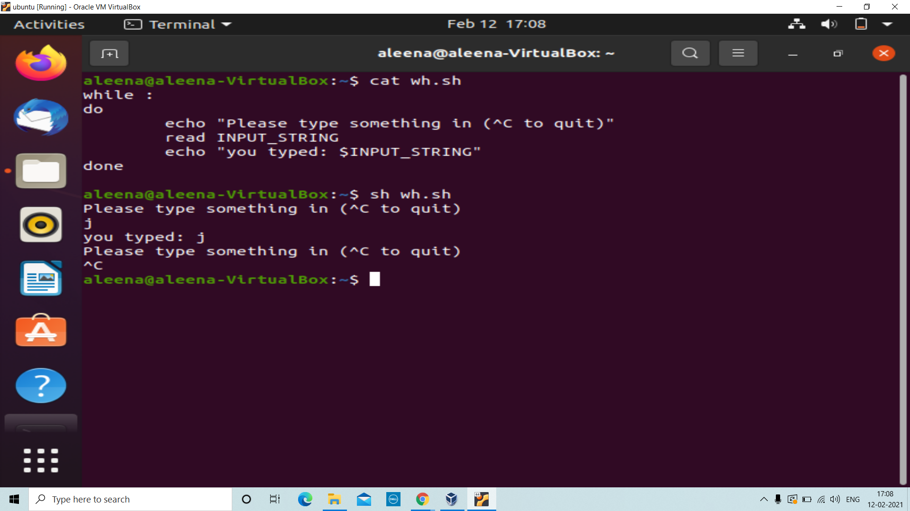
A simple shell script displaying the functioning of while loop.

Slide 6
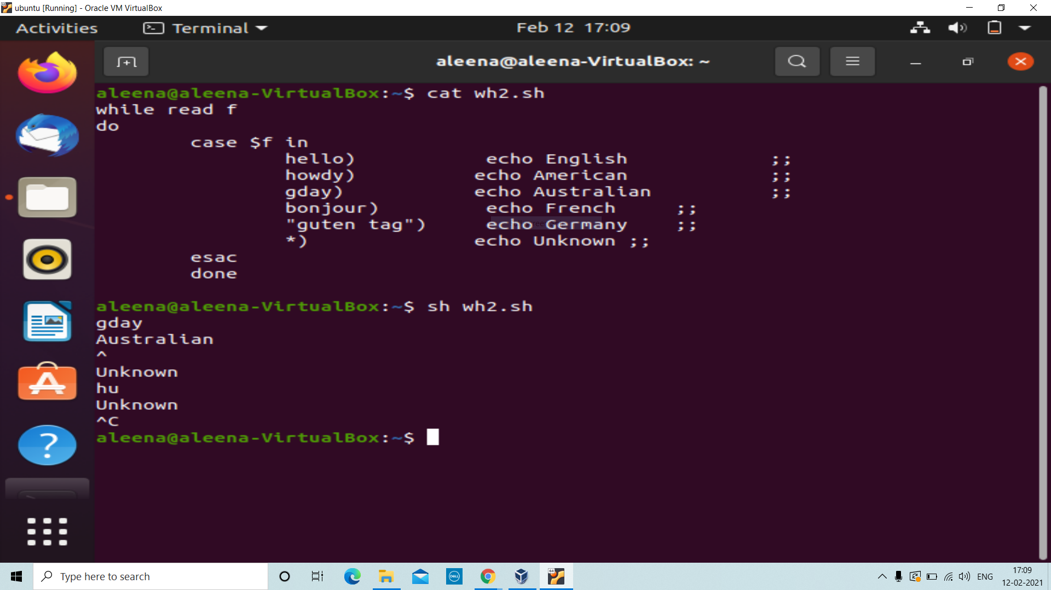
Shell script to display the input keyword belongs to which language using while …. Case loop.
Syntax: while [ expression]
do
case $a in …..
lines ;;
….. ;;
esac
done

Slide 7
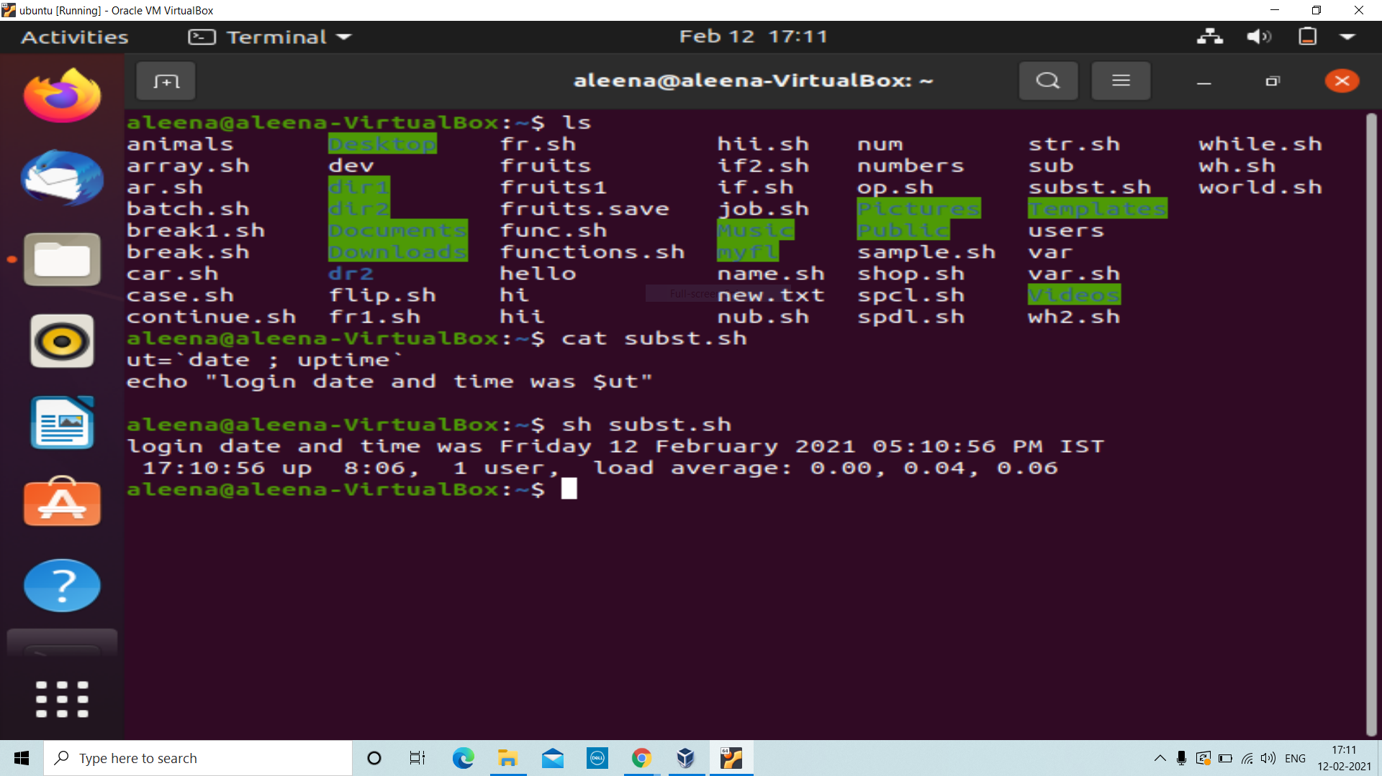
Shell script displaying how to substitute commands.
Here ‘date & uptime’ commands are substituted to another file and displayed.

Slide 8
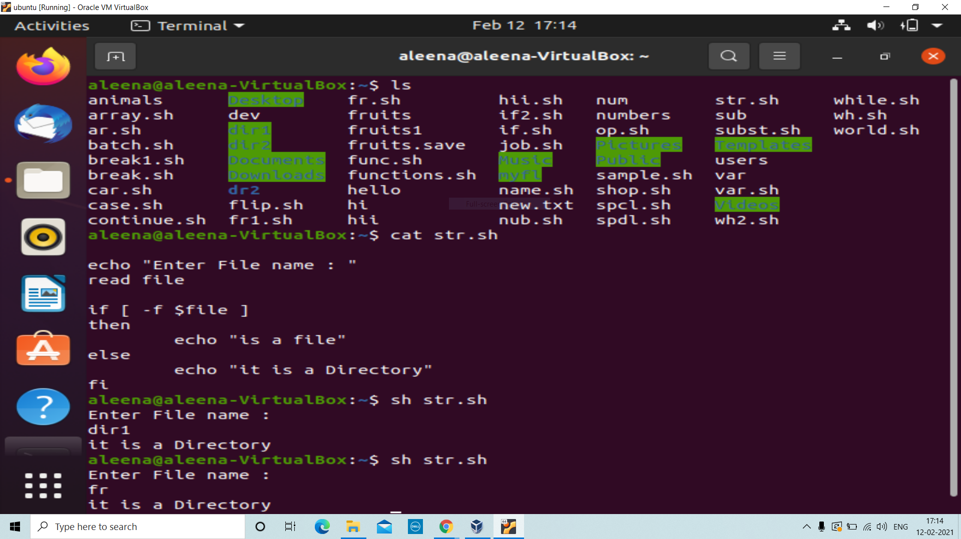
Shell script using if …. Else
Here is s code to display whether the input given is a file or directory.
Syntax: if [ expression ]
then
line1
else
line2
fi

Slide 9
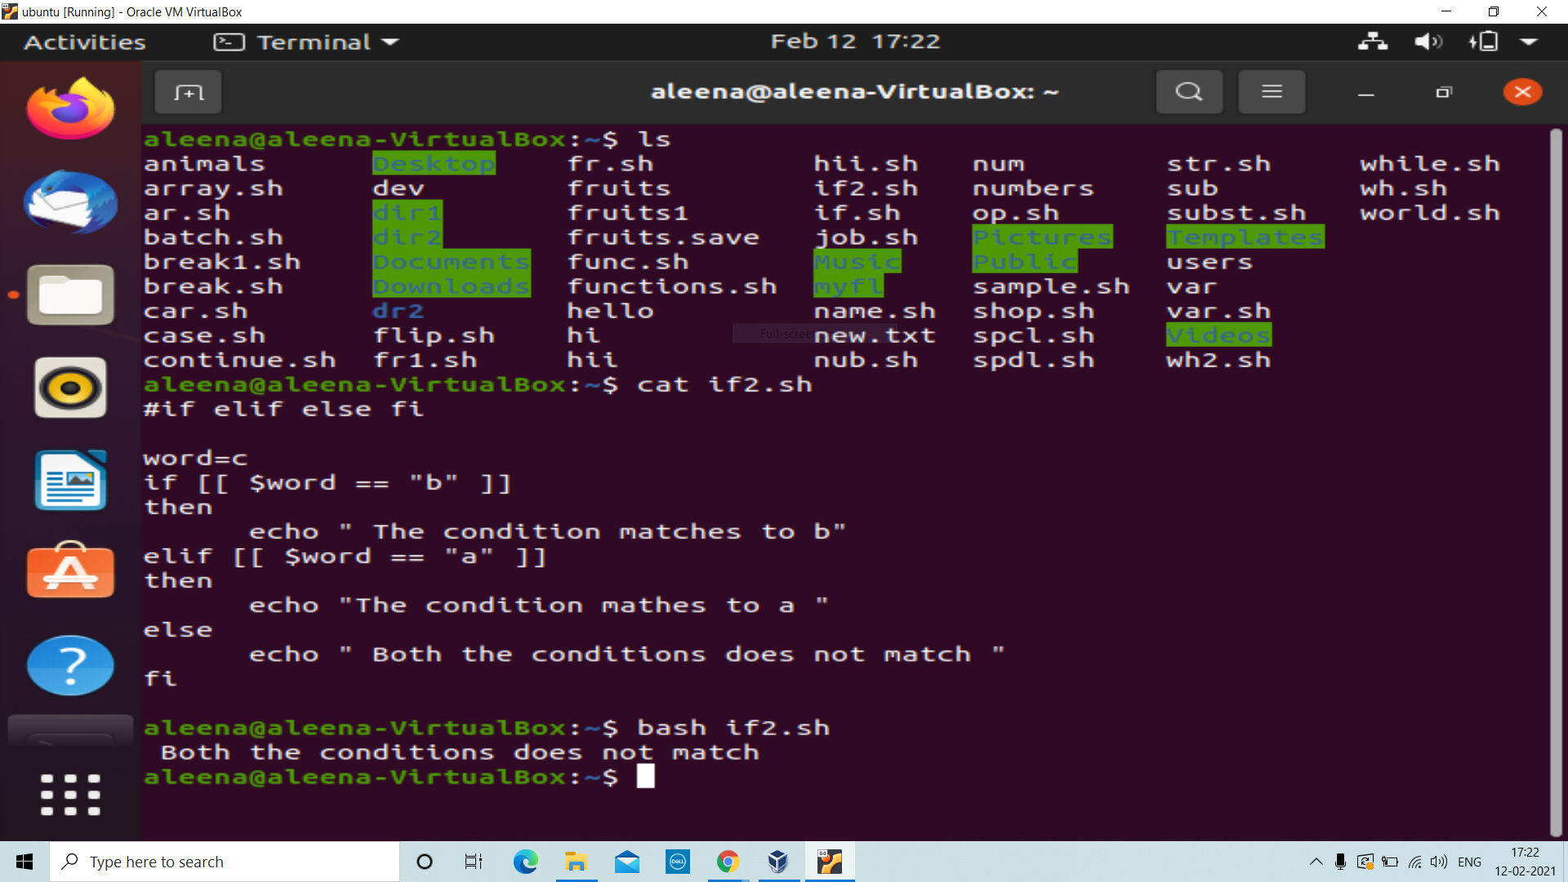
Shell script displaying if elif condition.
Syntax:
if [ expression 1 ]
then
Statement(s) to be executed if expression 1 is true
elif [ expression 2 ]
then
Statement(s) to be executed if expression 2 is true
elif [ expression 3 ]
then
Statement(s) to be executed if expression 3 is true
else
Statement(s) to be executed if no expression is true
fi

Slide 10
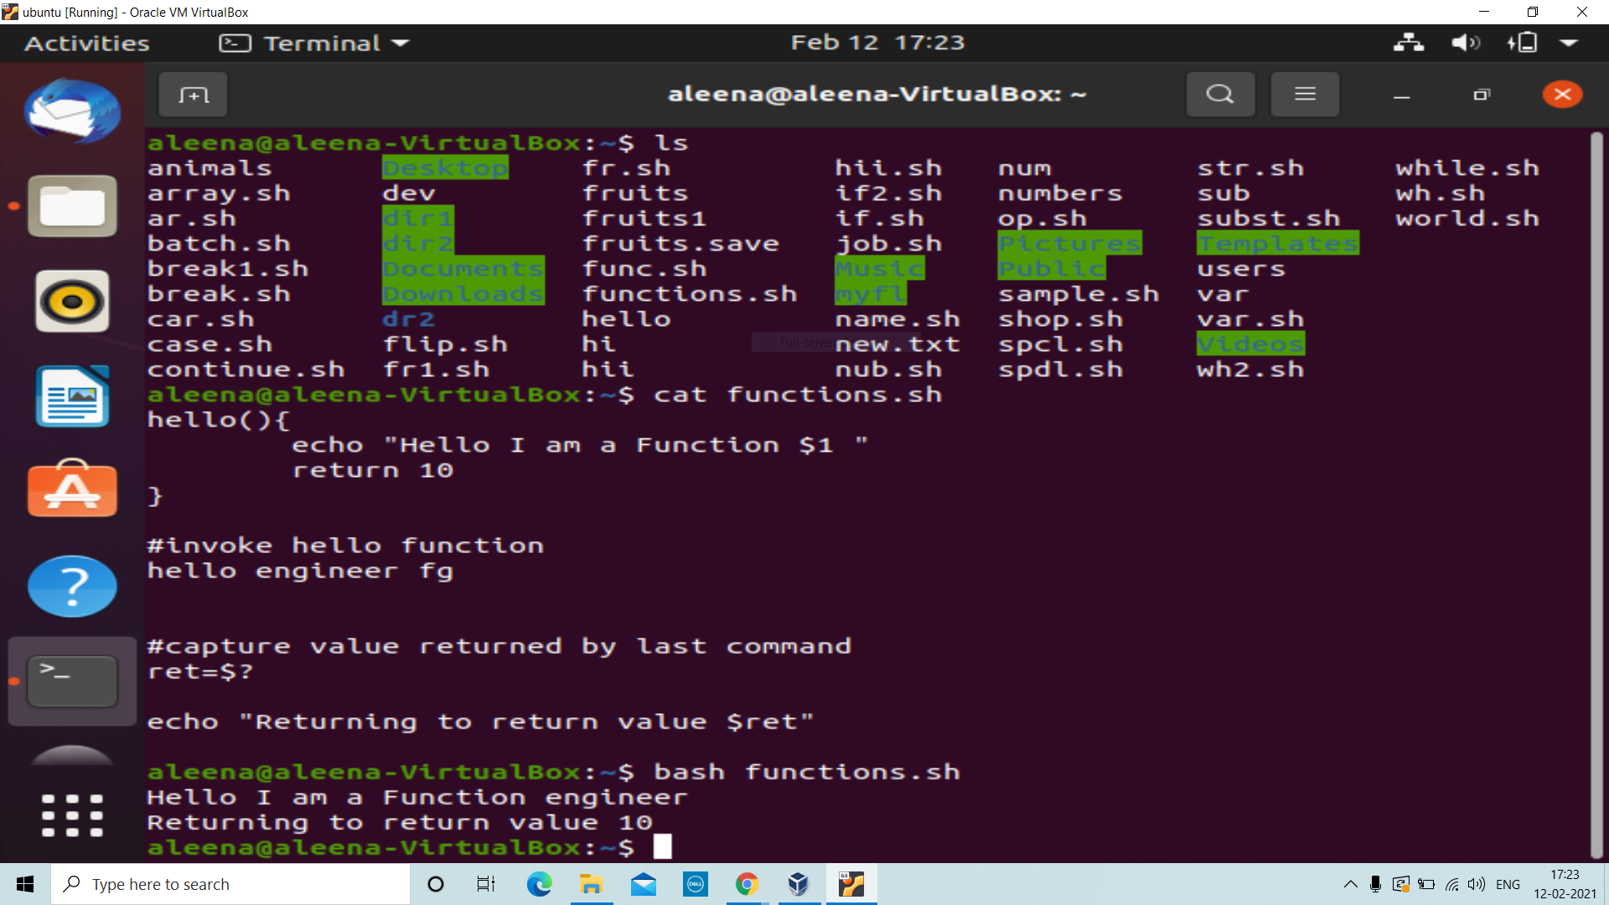
Invoking a Function:
Syntax for defining functions:
function_name()
{
…
<statements>
…
}

Slide 11
THANK YOU

